Slide 1
DECISION TREE REGRESSION
TOPICS
About Decision Tree Regression
Parameters
ID3 in brief
Decision Tree Intuition
Advantages
Disadvantages

Slide 2
Not sensitive to outliers
Not require Standardization
Supervised ML
Leads to overfitting
DECISION TREE
Classification/Regression
Overfitting can prevented by
Pre-pruning and post-pruning techniques.
Outputs:
1.classification:
Accuracy,Precission,recall,
F-score.
2.Regression:
R2-score,adjusted R2,MAE,RMSE,MAPE,MSPE
Parameters:
gini,entropy
Hyperparameters:
min_samples_split,
max_depth,
Post Pruning.

Slide 3
ABOUT DECISION TREE REGRESSION
A Decision Tree is a supervised machine-learning algorithm that can be used for both Regression and Classification problem statements. It divides the complete dataset into smaller subsets while, at the same time, an associated Decision Tree is incrementally developed.
So decision tree can be easily trained on a dataset by finding the best splits to make at each node. The Decision Trees’ final output is a Tree with Decision nodes and leaf nodes. A Decision Tree can operate on both categorical and numerical data

Slide 4
Process of split Decision Tree Regression
We have to calculate the standard deviation and standard deviation reduction
Based on the highest standard deviation we will start our splitting data
When the standard deviation is minimum than standard deviation reduction is maximum
We are construction decision tree based on the standard deviation reduction value .we have to calculate the entire dataset

Slide 5
Some of the important parameters are as follows
Max_depth: It represents the maximum depth of the tree. Default value is None.
Max_features: It represents the number of features to look for when deciding the best split. Default value is None.
Splitter: This parameter is used to choose the split at each node. Available values are “best” and “random”. Default value is best.

Slide 6
In order to prevent overfitting, we use two techniques
1.post pruning
2.pre pruning
Pruning:
It removes the branches of decision tree to overcome the overfitting
Post Pruning:
It is used when decision tree will have very large depth and will show overfitting of model
Pre Pruning:
This technique is used before construction of decision tree
It can be done using hyperparameter tuning
It overcomes the overfitting issue

Slide 7
ID3 in brief
ID3 stands for Iterative Dichotomizes3 and is named such because the algorithm iteratively (repeatedly) dichotomizes(divides) features into two or more groups at each step.Id3 is the is the most common decision tree algorithm. Dichotomizes means dividing into two completely opposite things. Algorithm iteratively divides attributes into two groups which are the most dominant attribute and others to construct a tree
ID3 Steps
Then it calculate the Standard Deviation and Standard Deviation Reduction of each attribute. In this way the most dominant attribute can be
Considering that all rows don’t belong to the same class, split the dataset S into subsets using the feature for which the Standard Deviation Reduction is maximum.
Make a decision tree node using the feature with the maximum Standard Deviation Reduction .

Slide 8
Metrics in ID3
The ID3 algorithm selects the best feature at each step while building a Decision tree.
ID3 select the best feature by using Standard Deviation Reduction to find the best feature.
Standard Deviation Reduction calculates the reduction in the Standard Deviation and measures how well a given feature separates the target classes. The feature with the highest Standard Deviation Reduction is selected as the best one.
Stopping based on node purity

Slide 9
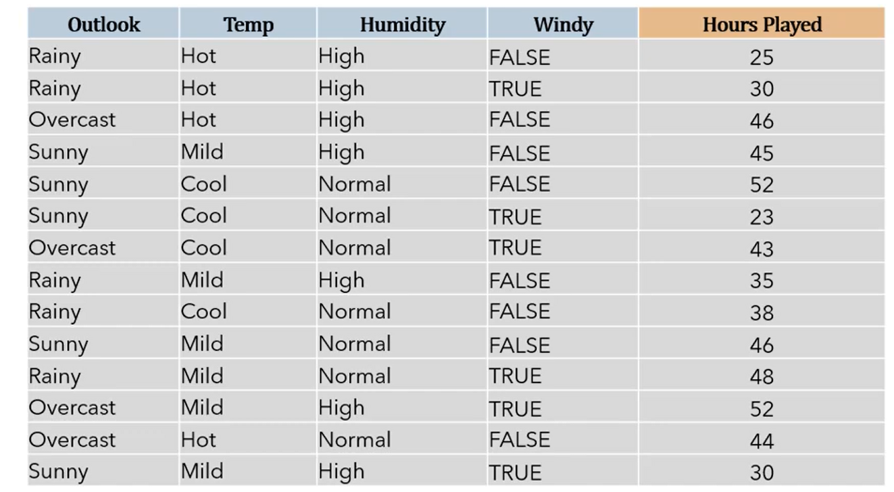

Slide 10
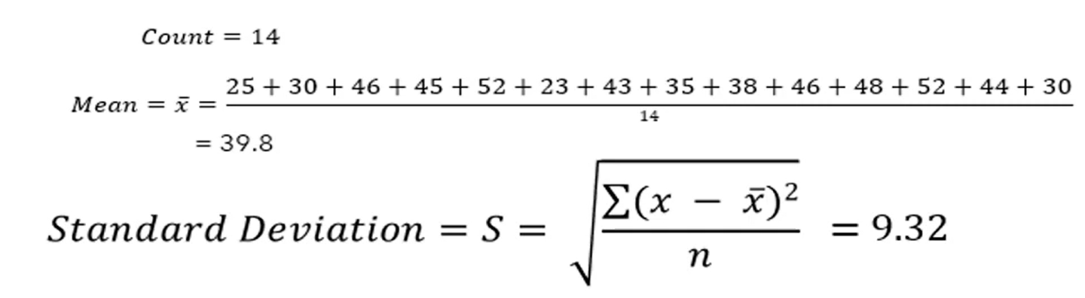
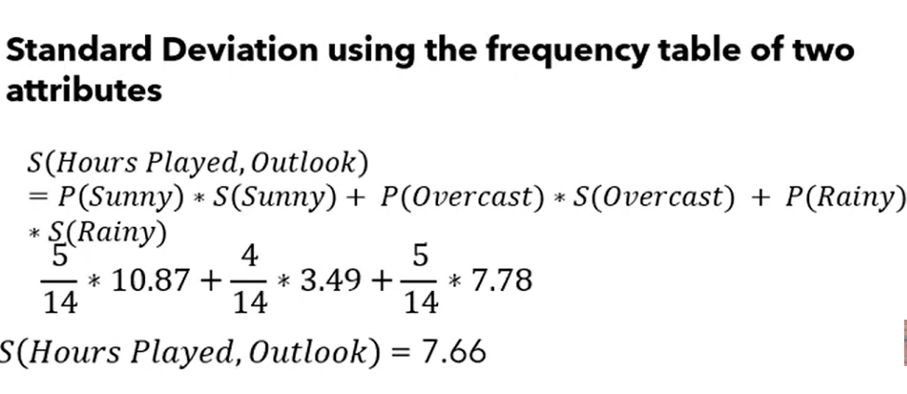
Standard Deviation Formula

Slide 11
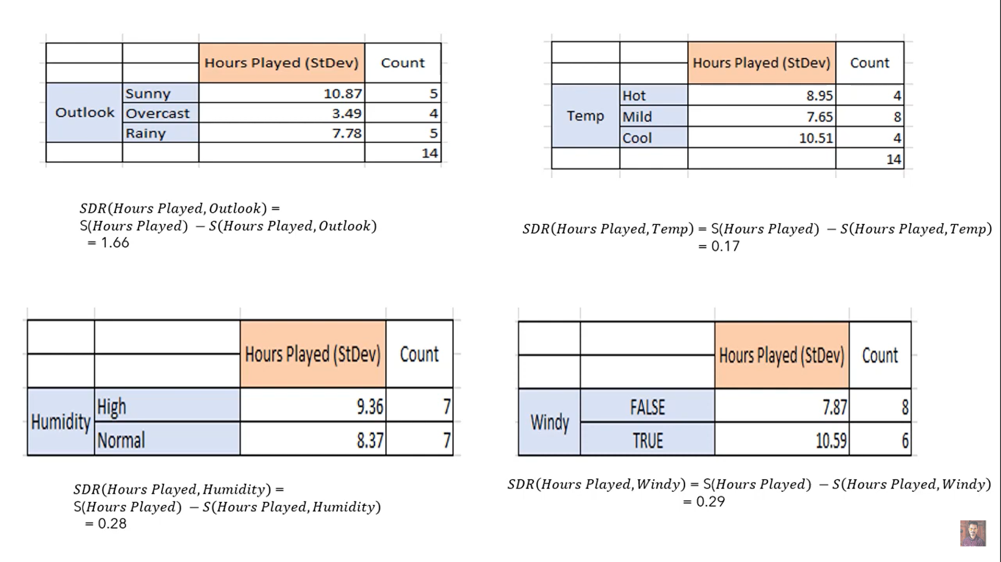

Slide 12
Co-efficient of variance
Co-efficient of variance=standard deviation/mean values in the dataset *100
Co-efficient of variance = σ/x̄ *100
we have some termination of criteria. Set a threshold value of for branch become smaller than certain threshold than subset will not need for further splitting

Slide 13
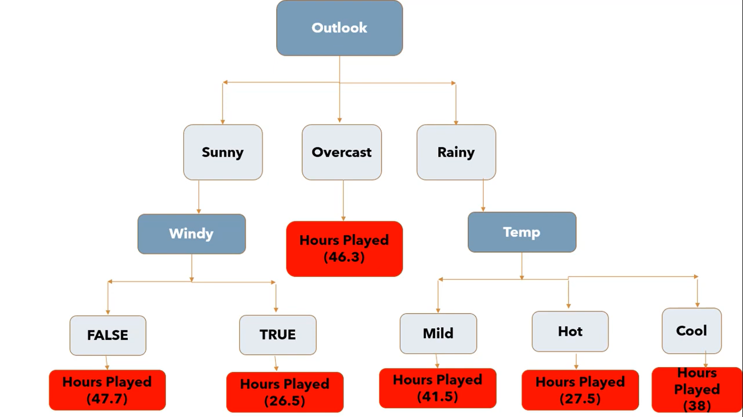

Slide 14
Advantages
They are fast
Robust
Requires very little experimentation
Compared with other algorithms, data preparation during pre-processing in a decision tree requires less effort and does not require normalization of data.
The implementation can also be done without scaling the data.
Disadvantages
Overfitting can easily occur
The decision tree algorithm looks for the pure node and doesn’t consider how the recent decision will affect the next few stages of splitting

Slide 15
THANK YOU

